Slide 1
SESSION 1
INTRODUCTION TO AI

Slide 2
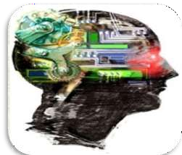
INTRODUCTION
Intelligence : “The capacity to learn and solve problems.”
Artificial Intelligence : Artificial Intelligence (AI) is the simulation of
human intelligence by machines.
The ability to solve problems.
The ability to act rationally.
The ability to act like humans.
The central principles of Al include :
Reasoning, knowledge, planning, learning and communication.
Perception and the ability to move and manipulate objects.
It is the science and engineering of making intelligent machines, especially intelligent computer programs

Slide 3
DEFINITION
Computers with the ability to mimic or duplicate the functions of the human brain.
Artificial Intelligence is the intelligence of machines and the branch of computer science which aims to create it.
"The branch of computer science that is concerned with the automation of intelligent behaviour" (Luger and Stubblefield. 1993).

Slide 4
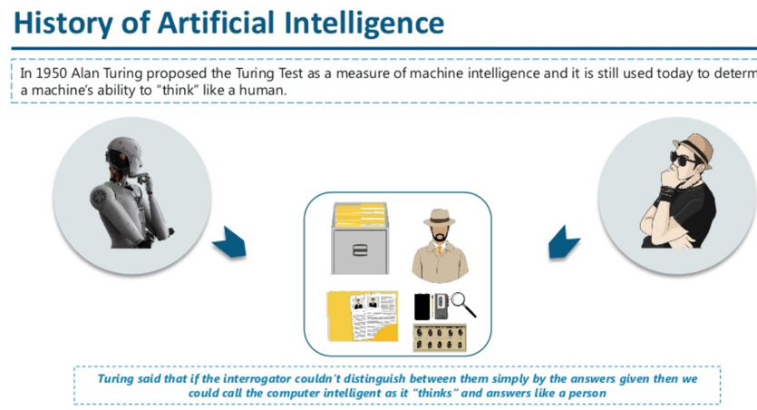

Slide 5
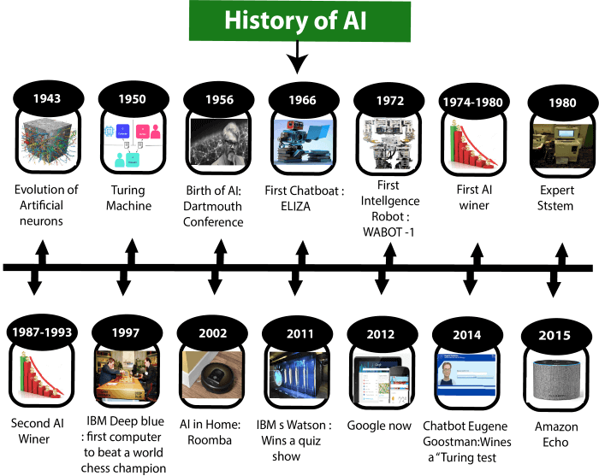

Slide 6
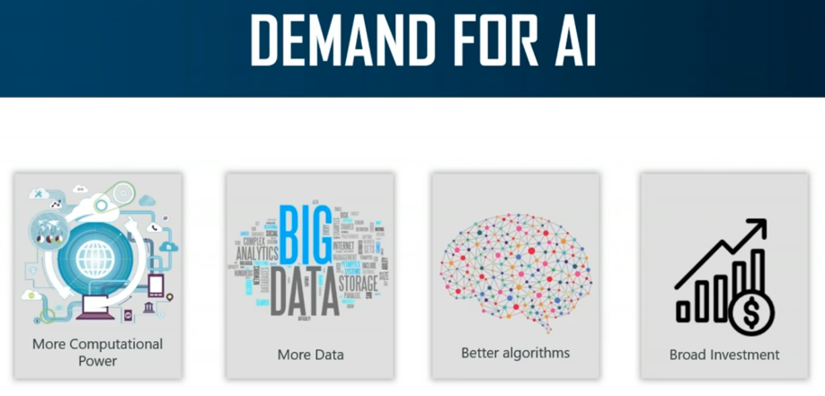

Slide 7
AI: GOALS
AMBITIOUS GOALS:
UNDERSTAND “INTELLIGENT” BEHAVIOR
BUILD “INTELLIGENT” AGENTS / ARTIFACTS
AUTONOMOUS SYSTEMS
UNDERSTAND HUMAN COGNITION (LEARNING,
REASONING, PLANNING, AND DECISION MAKING)
AS A COMPUTATIONAL PROCESS.

Slide 8
Thinking
A mental activity, is directed at solving a problem, making inferences, judging certain facts, and deciding and choosing between options.
• Base of all cognitive activities or processes and is unique to human beings
• Manipulation and analysis of the information received from the environment.
Thinking relies on knowledge
• Problem solving is thinking that is goal oriented.
• Process of recall and application of information recalled.

Slide 9
WHAT IS AI?
Views of AI fall into four different perspectives --- two dimensions:
1) Thinking versus Acting
2) Human versus Rational (which is “easier”?)
Human-like
Intelligence
“Ideal” Intelligent/
Pure Rationality
Thought/
Reasoning
(“modeling thought /
brain)
2. Thinking humanly | 3. Thinking Rationally
1. Acting Humanly | 4. Acting Rationally
Behavior/
Actions
“behaviorism”
“mimics behavior”
Notes:
A system is intelligent if it does the right thing given what it knows.

Slide 10
1. ACTING HUMANLY
Human-like
Intelligence
“Ideal” Intelligent/
Rationally
2. Thinking humanly | 3. Thinking Rationally
1. Acting Humanly 🡪Turing Test | 4. Acting Rationally
Thought/
Reasoning
Behavior/
Actions
Notes:
A system is intelligent if it does the right thing given what it knows.

Slide 11
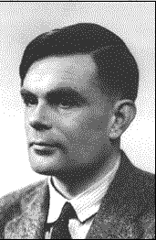
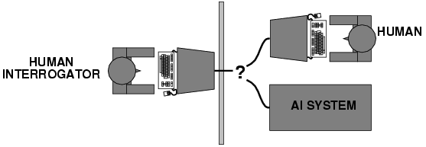
ACTING HUMANLY: TURING TEST
Turing (1950) "Computing machinery and intelligence”
Alan Turing
"Can machines behave intelligently?"
Operational test for intelligent behavior: the imitation game
Predicted, a machine might have a 30% chance of fooling a lay person for 5 minutes.
But, by scientific consensus, we are still several decades away
From truly passing the turing test (as the test was intended).
AI system passes
if interrogator
cannot tell which one
is the machine.
(interaction via written questions)
No computer vision or robotics or physical presence required!

Slide 12
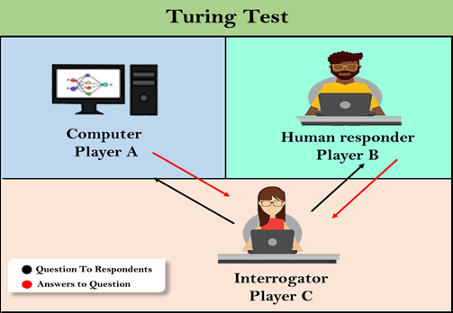
The questions and answers can be like:
Interrogator: Are you a computer?
PlayerA (Computer): No
Interrogator: Multiply two large numbers such as (256896489*456725896)
Player A: Long pause and give the wrong answer.
In this game, if an interrogator would not be able to identify which is a machine and which is human, then the computer passes the test successfully, and the machine is said to be intelligent and can think like a human.

Slide 13
CHATBOTS TO ATTEMPT THE TURING TEST:
ELIZA: ELIZA was a natural language processing computer program created by joseph weizenbaum. It was created to demonstrate the ability of communication between machine and humans. It was one of the first chatterbots, which has attempted the turing test.
Parry: parry was a chatterbot created by kenneth colby in 1972. Parry was designed to simulate a person with paranoid schizophrenia(most common chronic mental disorder). Parry was described as "ELIZA with attitude." Parry was tested using a variation of the turing test in the early 1970s.
Eugene goostman: eugene goostman was a chatbot developed in saint petersburg in 2001. This bot has competed in the various number of turing test. In june 2012, at an event, goostman won the competition promoted as largest-ever turing test content, in which it has convinced 29% of judges that it was a human.Goostman resembled as a 13-year old virtual boy.

Slide 14
THE CHINESE ROOM ARGUMENT
There were many philosophers who really disagreed with the complete concept of Artificial Intelligence. The most famous argument in this list was "Chinese Room."
In the year 1980, John Searle presented "Chinese Room" thought experiment, in his paper "Mind, Brains, and Program," which was against the validity of Turing's Test. According to his argument, "Programming a computer may make it to understand a language, but it will not produce a real understanding of language or consciousness in a computer."
He argued that Machine such as ELIZA and Parry could easily pass the Turing test by manipulating keywords and symbol, but they had no real understanding of language. So it cannot be described as "thinking" capability of a machine such as a human.

Slide 15

ELIZA: IMPERSONATING A ROGERIAN PSYCHOTHERAPIST
1960s ELIZA Joseph Weizenbaum
You: Well, I feel sad
Eliza: Do you often feel sad?
You: not very often.
Eliza: Please go on.
☺

Slide 16
2. THINKING HUMANLY
Human-like
Intelligence
“Ideal” Intelligent/
Rationally
2. Thinking humanly 🡪 Cognitive Modeling | Thinking Rationally
Acting Humanly 🡪Turing Test | Acting Rationally
Thought/
Reasoning
Behavior/
Actions
Notes:
A system is intelligent if it does the right thing given what it knows.

Slide 17
THINKING HUMANLY
Cognitive Revolution (1960s)
Information-processing Psychology Replaced
Prevailing Orthodoxy Of Behaviorism
Requires Scientific Theories Of Internal Activities Of The Brain . . .
– What Level Of Abstraction?
– “Knowledge” Or “Circuits”?
And Validation
– Predicting And Testing Behavior Of Human Subjects (Top-down)
⇒ Cognitive Science
– Direct Identification From Neurological Data (Bottom-up)
⇒ Cognitive Neuroscience

Slide 18
So,
In near future, we can have computers with as many processing elements as our brain, but:
Far fewer interconnections (wires or synapses)
Then again, much faster updates.
Fundamentally different hardware may
Require fundamentally different algorithms!
Still an open question.
Neural net research.
Can a digital computer simulate our brain?

Slide 19
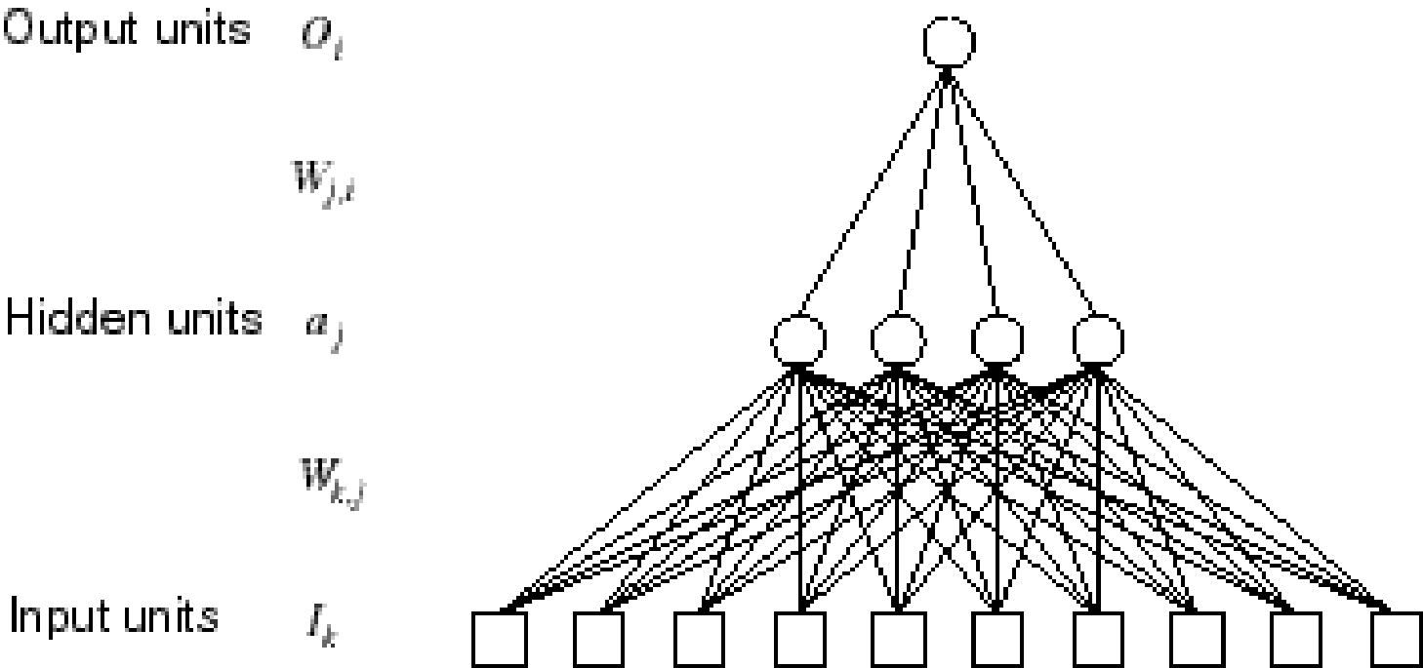
AN ARTIFICIAL NEURAL NETWORK (PERCEPTRONS)
Output Unit
Input Units

Slide 20
3. THINKING RATIONALLY
Human-like
Intelligence
“Ideal” Intelligent/
Rationally
Thinking humanly 🡪 Cognitive Modeling | 3. Thinking Rationally 🡪formalizing ”Laws of Thought”
Acting Humanly 🡪Turing Test | Acting Rationally
Thought/
Reasoning
Behavior/
Actions
Notes:
A system is intelligent if it does the right thing given what it knows.

Slide 21
3. THINKING RATIONALLY
The Study Of Mental Faculties Through The Use Of Computational Models; That It Is, The Study Of Computations That Make It Possible To Perceive Reason And Act.Several Greek Schools Developed Various Forms Of Logic:
– Notation
– Rules Of Derivation (Syllogisms)
Direct Line Through Mathematics And Philosophy To Modern Ai
Eg
“SOCRATES IS A MAN. ALL MEN ARE MORTAL. THEREFORE SOCRATES IS MORTAL”

Slide 22
Rational Agents
Agent
An entity that perceives and acts
A useful way to think about building AI programs is in terms of designing (and implementing) rational agents
Abstract definition
An agent is a function from percept histories to actions:
f : P∗ → A

Slide 23
4. ACTING RATIONALLY
Human-like
Intelligence
“Ideal” Intelligent/
Rationally
Thinking humanly 🡪 Cognitive Modeling | Thinking Rationally 🡪formalizing ”Laws of Thought”
Acting Humanly 🡪Turing Test | Acting Rationally
Thought/
Reasoning
Behavior/
Actions
Notes:
A system is intelligent if it does the right thing given what it knows.

Slide 24
Acting Rationally
Acting Rationally Means Acting To Achieve One’s Goals, Given One’s Beliefs Or Understanding About The World.
When Constructing An Intelligent Agent, Emphasis Shifts From Designing The Theoretically Best Decision-making Procedure To Designing The Best Decision-making Procedure Possible Within The Circumstances In Which The Agent Is Acting.
Logical Approaches May Be Used To Help Find The Best Action, But There Are Also Other Approaches.
Achieving So-called “Perfect Rationality”, Making The Best Decision Theoretically Possible, Is Not Usually Possible Due To Limited Resources In A Real Environment (E.G., Time, Memory, Computational Power, Uncertainty, Etc.).
The Trick Is To Do The Best With The Information And Resources You Have. This Represents A Shift In The Field Of AI From Optimizing (Early AI) To Satisfying (More Recent AI).

Slide 25
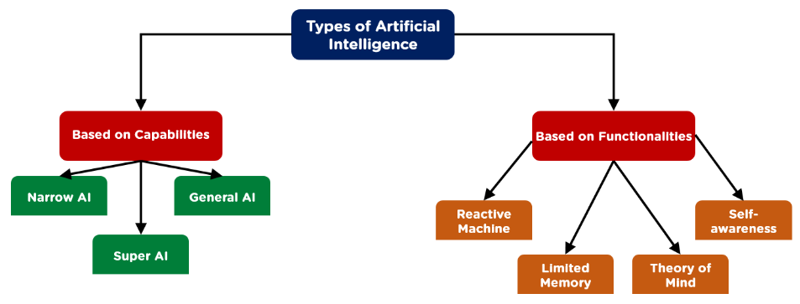
TYPES OF ARTIFICIAL INTELLIGENCE

Slide 26
TYPES OF ARTIFICIAL INTELLIGENCE-TYPE 1
Narrow AI is a type of AI which is able to perform a dedicated task with intelligence. The most common and currently available AI is Narrow AI in the world of Artificial Intelligence.
Narrow AI cannot perform beyond its field or limitations, as it is only trained for one specific task. Hence it is also termed as weak AI. Narrow AI can fail in unpredictable ways if it goes beyond its limits.
Apple Siri a good example of Narrow AI, but it operates with a limited pre-defined range of functions.
IBM's Watson supercomputer also comes under Narrow AI, as it uses an Expert system approach combined with Machine learning and natural language processing.
Some Examples of Narrow AI are playing chess, purchasing suggestions on e-commerce site, self-driving cars, speech recognition, and image recognition.

Slide 27
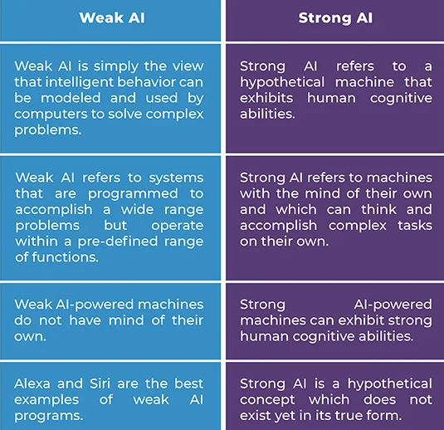
WEAK AI VS STRONG AI

Slide 28
TYPES OF ARTIFICIAL INTELLIGENCE-TYPE 1
2. General AI:
General AI is a type of intelligence which could perform any intellectual task with efficiency like a human.
The idea behind the general AI to make such a system which could be smarter and think like a human by its own.
3. Super AI:
Super AI is a level of Intelligence of Systems at which machines could surpass human intelligence, and can perform any task better than human with cognitive properties. It is an outcome of general AI.
Some key characteristics of strong AI include capability include the ability to think, to reason, solve the puzzle, make judgments, plan, learn, and communicate by its own.
Super AI is still a hypothetical concept of Artificial Intelligence. Development of such systems in real is still world changing task.

Slide 29
TYPES OF ARTIFICIAL INTELLIGENCE-TYPE 2
1. Reactive Machines
Purely reactive machines are the most basic types of Artificial Intelligence.
Such AI systems do not store memories or past experiences for future actions.
These machines only focus on current scenarios and react on it as per possible best action.
IBM's Deep Blue system,Google's AlphaGo is also an example of reactive machines.
2. Limited Memory
Limited memory machines can store past experiences or some data for a short period of time.
These machines can use stored data for a limited time period only.
Self-driving cars are one of the best examples of Limited Memory systems. These cars can store recent speed of nearby cars, the distance of other cars, speed limit, and other information to navigate the road.

Slide 30
TYPES OF ARTIFICIAL INTELLIGENCE-TYPE 2
3. Theory of Mind
Theory of Mind AI should understand the human emotions, people, beliefs, and be able to interact socially like humans.
This type of AI machines are still not developed, but researchers are making lots of efforts and improvement for developing such AI machines.
Eg One real-world example of the theory of mind AI is Kismet, Sophia from Hanson Robotics
4. Self-Awareness
Self-awareness AI is the future of Artificial Intelligence. These machines will be super intelligent, and will have their own consciousness, sentiments, and self-awareness.
These machines will be smarter than human mind.
Self-Awareness AI does not exist in reality still and it is a hypothetical concept.

Slide 31
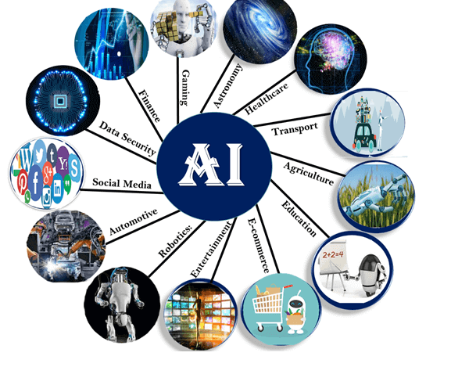
Artificial Intelligence Applications

Slide 32
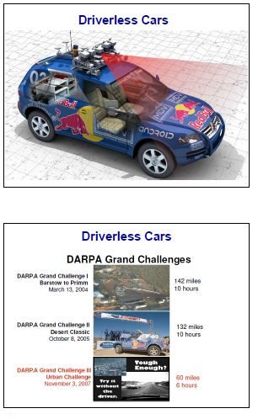
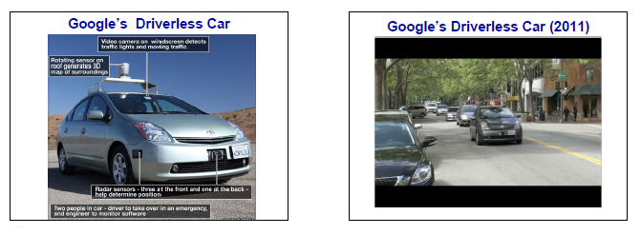
TRANSPORT

Slide 33
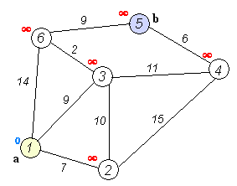
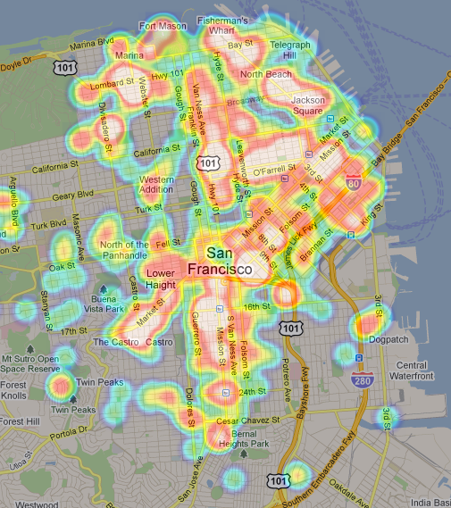
TRANSPORT
Google’s AI-Powered Predictions

Slide 34
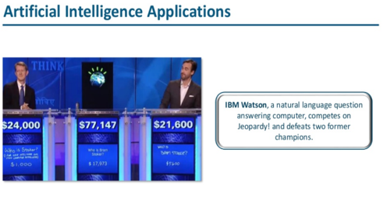
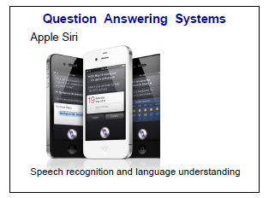
Smart Personal Assistants

Slide 35
Smart Personal Assistants
Amazon Expanded Upon This Model With The Announcement Of Complimentary Hardware And Software Components:
Alexa, An Ai-powered Personal Assistant That Accepts Voice Commands To Create To-do Lists, Order Items Online, Set Reminders, And Answer Questions (Via Internet Searches)
Echo (And Later, Dot) Smart Speakers That Allow You To Integrate Alexa Into Your Living Room And Use Voice Commands To Ask Natural Language Questions, Play Music, Order Pizza, Hail An Uber, And Integrate With Smart Home Devices.
Microsoft Has Followed Suit With Cortana, Its Own AI Assistant That Comes Pre-loaded On Windows Computers And Microsoft Smartphones.

Slide 36
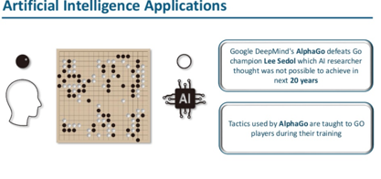
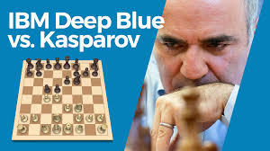
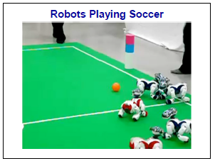
GAMING

Slide 37
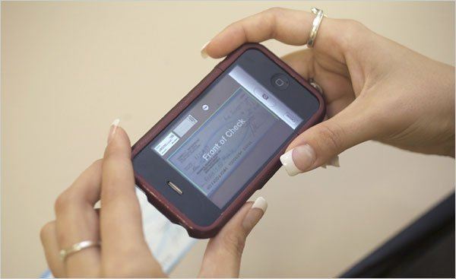

FINANCE
Mobile Check Deposits
Fraud Prevention
Credit Decisions

Slide 38
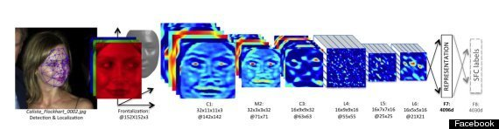
SOCIAL MEDIA
Facebook’s facial recognition
Pinterest: automatically identify objects in images (or “pins”) and then recommend visually similar pins. Other applications of machine learning at Pinterest include spam prevention, search and discovery, ad performance and monetization, and email marketing.
Instagram:to identify the contextual meaning of emoji, which have been steadily replacing slang
snapchat: filters track facial movements, allowing users to add animated effects or digital masks that adjust when their faces moved.

Slide 39

ONLINE SHOPPING
Search
Recommendations
Fraud Protection

Slide 40
Grading and Assessment
Plagiarism Checkers
Many high school and college students are familiar with services like Turnitin, a popular tool used by instructors to analyze students’ writing for plagiarism.
Robo-readers
Essay grading is very labor intensive, which has encouraged researchers and companies to build essay-grading AIs.
The Graduate Record Exam (GRE), the primary test used for graduate school, grades essays using one human reader and one robo-reader called e-Rater.

Slide 41

Health Sector
A deep learning model named COVID-19 detection neural network (COVNet), was developed to extract visual features from 4,356 computed tomography (CT) exams from 3,322 patients for the detection of COVID-19.
Early detection and epidemic analysis
Containment
Triage and diagnosis

Slide 42
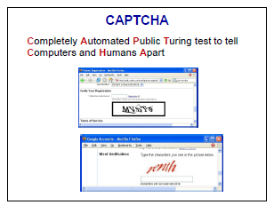
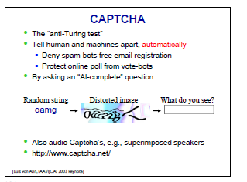
SOME AI PROBLEMS ARE VERY HARD

Slide 43
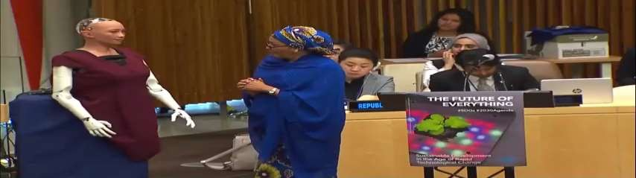
HUMANOID ROBOT
Sophia is a social humanoid robot developed by Hong Kong based company Hanson Robotics.
Sophia was activated on April 19,2015.
She made her first public appearance at South by Southwest Festival in mid-March 2016 in United States.
In October 2017 Sophia became a Saudi Arabian citizen, the first robot to receive citizenship in any country.

Slide 44
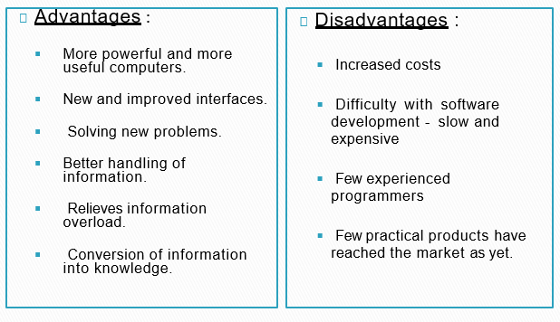
ADVANTAGES N DISADVANTAGES

Slide 45
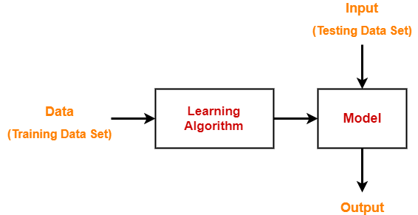
Machine Learning-
Dataset contains a lot of separate pieces of data but can be used to train an algorithm with the goal of finding predictable patterns inside the whole dataset.

Slide 46
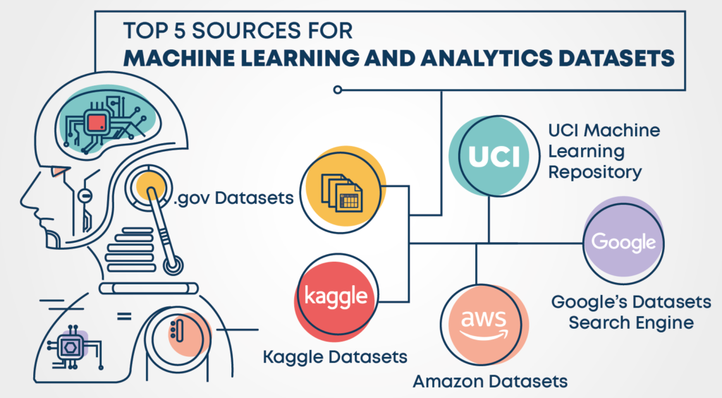
Popular sources for Machine Learning datasets

Slide 47
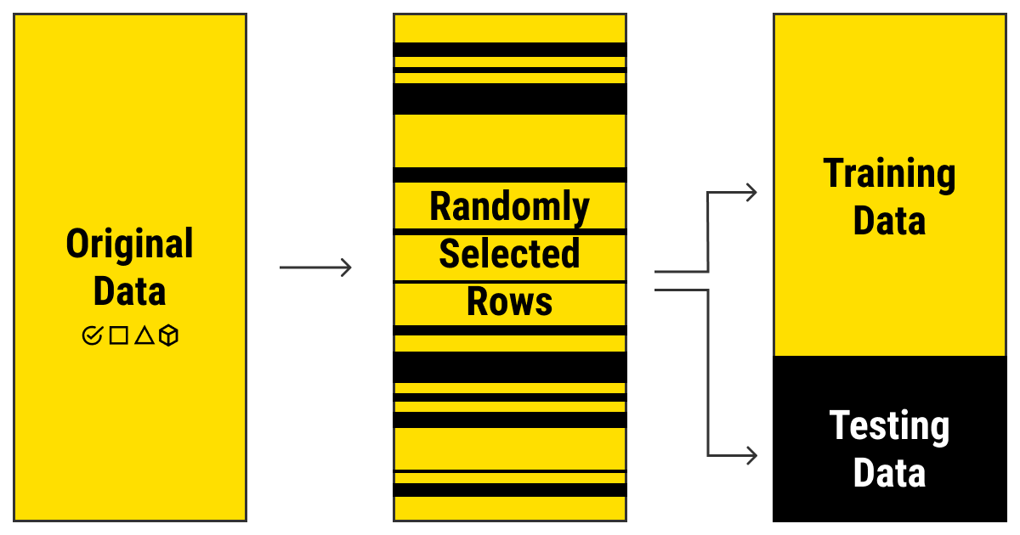

Slide 48
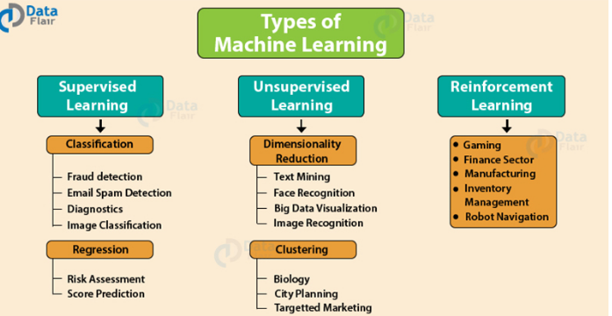

Slide 49
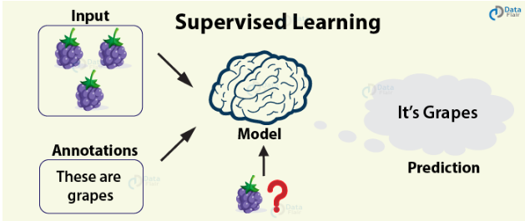
Supervised Learning

Slide 50
Supervised Learning
Supervised Learning is the most popular paradigm for performing machine learning operations.
It is widely used for data where there is a precise mapping between input-output data.
The dataset, in this case, is labeled, meaning that the algorithm identifies the features explicitly and carries out predictions or classification accordingly.
As the training period progresses, the algorithm is able to identify the relationships between the two variables such that we can predict a new outcome.

Slide 51
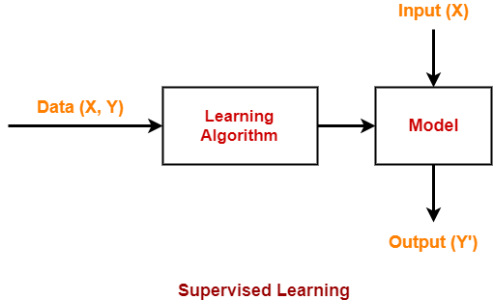
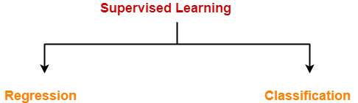

Slide 52
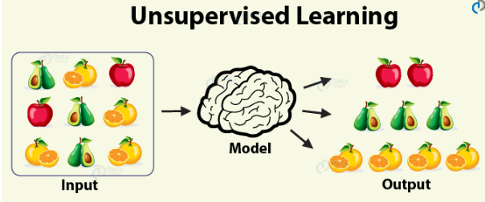
Unsupervised Learning

Slide 53
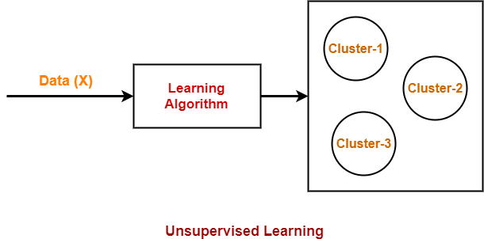

Slide 54
Unsupervised learning algorithm
In the case of unsupervised learning algorithm, the data is not explicitly labeled into different classes, that is, there are no labels.
The model is able to learn from the data by finding implicit patterns.
Unsupervised Learning algorithms identify the data based on their densities, structures, similar segments, and other similar features.
Unsupervised Learning Algorithms are based on Hebbian Learning.
Cluster analysis is one of the most widely used techniques in supervised learning.

Slide 55

Reinforcement Learning
Reinforcement Learning covers more area of Artificial Intelligence which allows machines to interact with their dynamic environment in order to reach their goals.
With this, machines and software agents are able to evaluate the ideal behavior in a specific context.
With the help of this reward feedback, agents are able to learn the behavior and improve it in the longer run.
This simple feedback reward is known as a reinforcement signal.

Slide 56
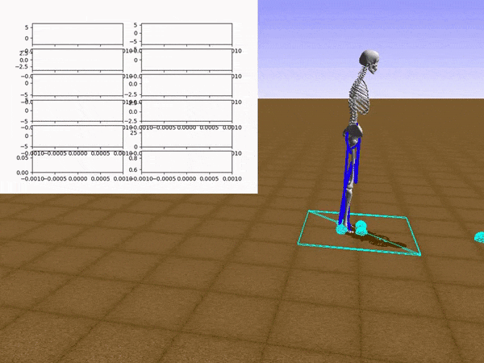
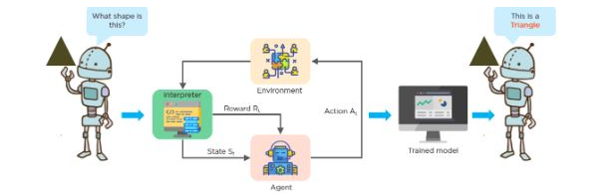

Slide 57
KEY RESEARCH AREAS IN AI
Problem Solving, Planning, And Search --- Generic Problem Solving Architecture Based On Ideas From Cognitive Science (Game Playing, Robotics).
Knowledge Representation – To Store And Manipulate Information (Logical And Probabilistic Representations)
Automated Reasoning / Inference – To Use The Stored Information To Answer Questions And Draw New Conclusions
Machine Learning – Intelligence From Data; To Adapt To New Circumstances And To Detect And Extrapolate Patterns
Natural Language Processing – To Communicate With The Machine
Computer Vision --- Processing Visual Information
Robotics --- Autonomy, Manipulation, Full Integration Of AI Capabilities

Slide 58
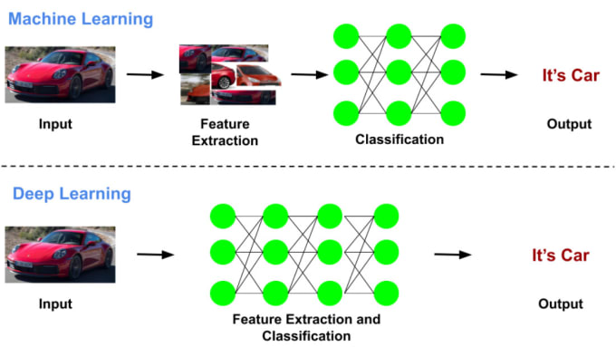

Slide 59
